Slide 1
Vendor Management Mockups

Slide 2
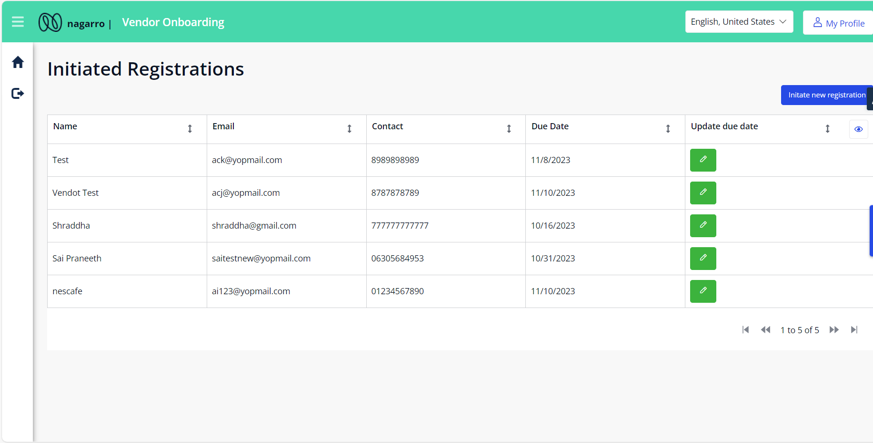
Vendor Onboarding –Registration Overview (Initiator)

Slide 3
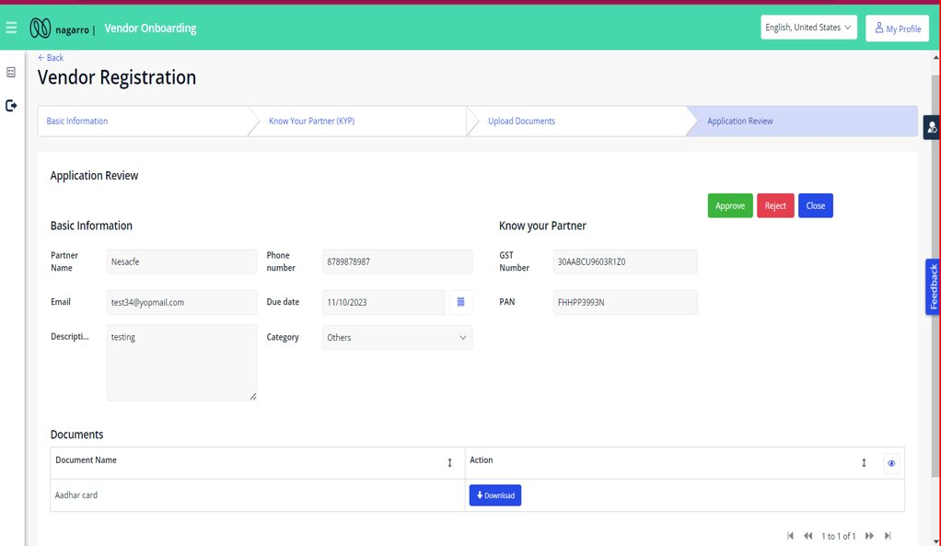
Vendor Onboarding –Application Review (Approver)

Slide 4
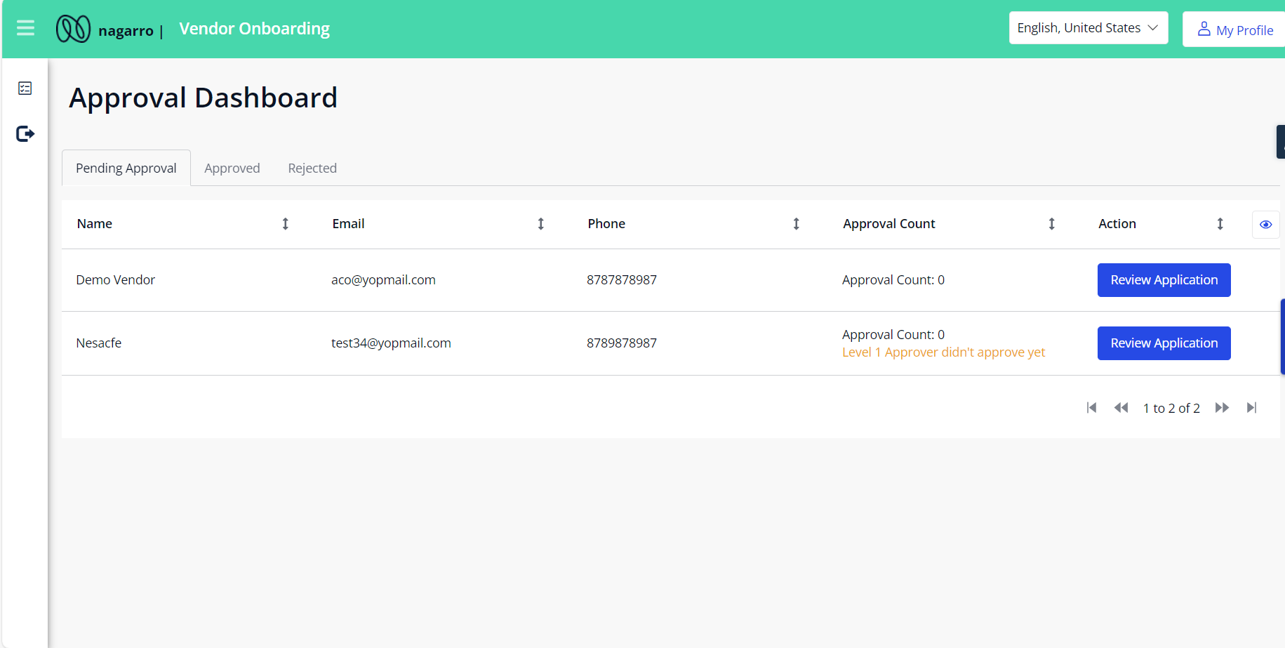
Vendor Onboarding –Approval Dashboard

Slide 5
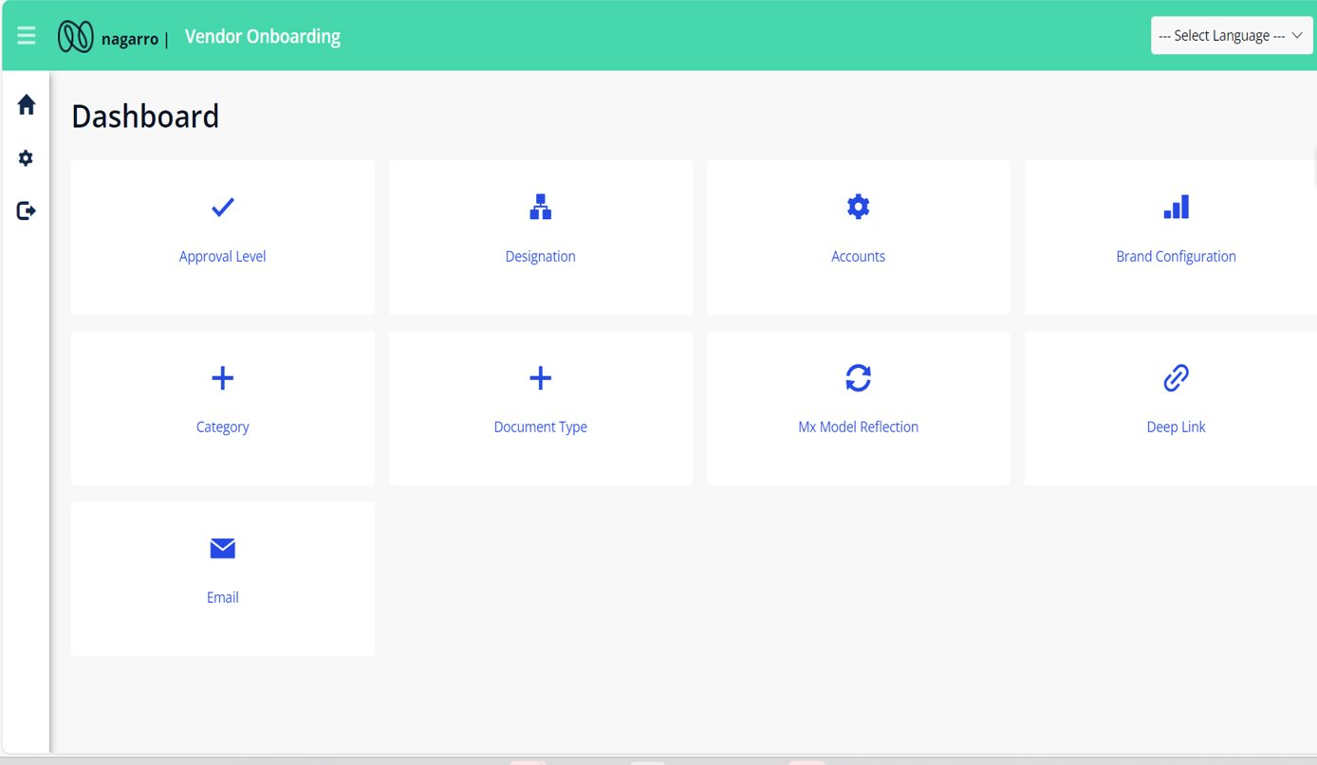
Vendor Onboarding –Admin Dashboard

